Slide 1
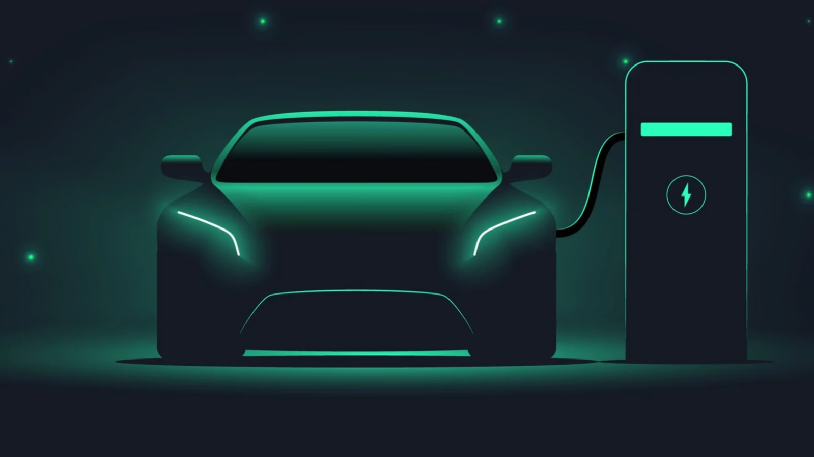

Slide 2
INTRODUCTION
The Real-Time EV Fleet Monitoring and Predictive Analytics Solution is a comprehensive system designed to empower fleet managers with the tools and insights needed to efficiently monitor and manage electric vehicles (EVs). By utilizing real-time tracking and advanced predictive analytics, this solution addresses key challenges in fleet management. It provides detailed insights into critical aspects such as battery health, charging status, and range estimations. These features enable fleet managers to plan better, perform proactive maintenance, and minimize unexpected downtime. Additionally, the system supports optimized operations by analyzing energy consumption and usage patterns, helping to reduce costs and improve overall fleet efficiency. This all-in-one solution is tailored to meet the evolving needs of the EV industry, driving smarter decision-making and operational excellence.

Slide 3
PROJECT OVERVIEW
Real-Time Monitoring: Track EV performance, location, and battery status.
Active and Inactive Vehicle Tracking: Tracking the status of active and inactive vehicles.
User Authentication: Secure access with role-based permissions for managers and drivers.
Range prediction: Range prediction based on EV model chosen and battery level.

Slide 4
CUSTOMER FEATURES
User Registration and Login: Registration with username, email, password and role. Login validation with email and password.
Role – based access: Dashboard with prediction option feature for drivers and dashboard with Dataset, Distributions, Relationships, Vehicle Status and Prediction features for Managers.
Prediction based on EV model : Range prediction results based on the EV model chosen as trained on various parameters.
Graphs on distributions and relationships : Fleet managers get to access visualizations based on the dataset.

Slide 5
STAGES
User Registration and Login Authentication
Synthetic Data Generation
Dashboard Building
Model training and Prediction Implementation

Slide 6
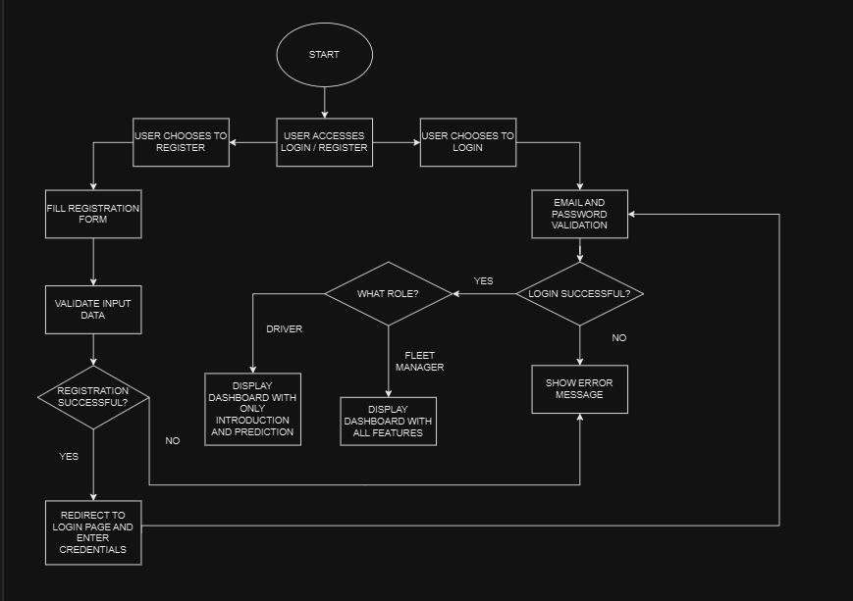

FLOWCHART

Slide 7
REQUIREMENTS
SYNTHETIC DATA GENERATION
Faker 30.8.2
Pandas 2.2.2
NumPy 1.26.4
Scikit-learn 1.5.2
FRONTEND
HTML 5
CSS
JavaScript
DATABASE
MySQL 8.0
BACKEND
Node 20.17.0
Flask 3.0.3

Slide 8
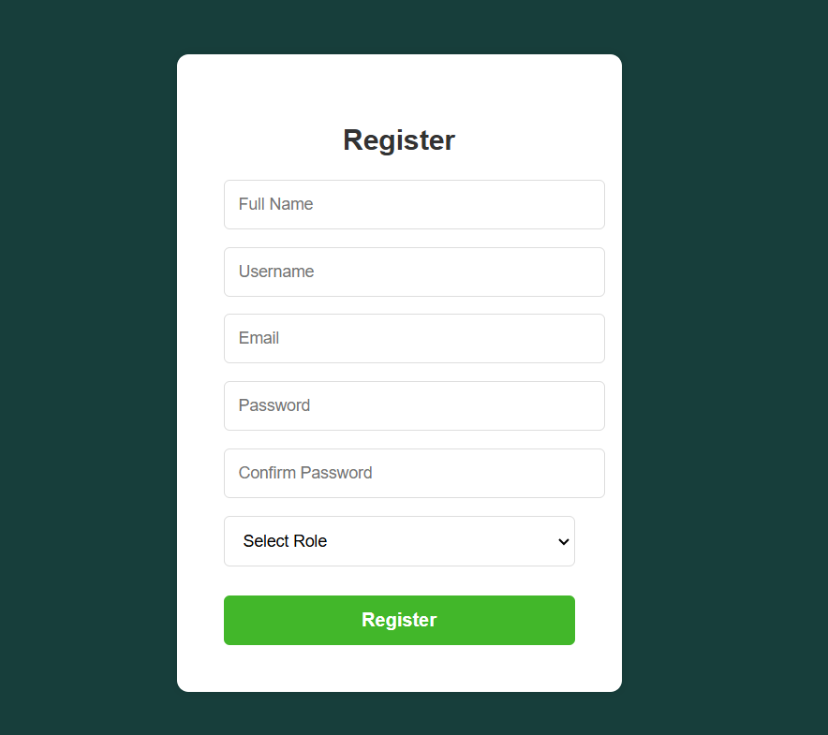
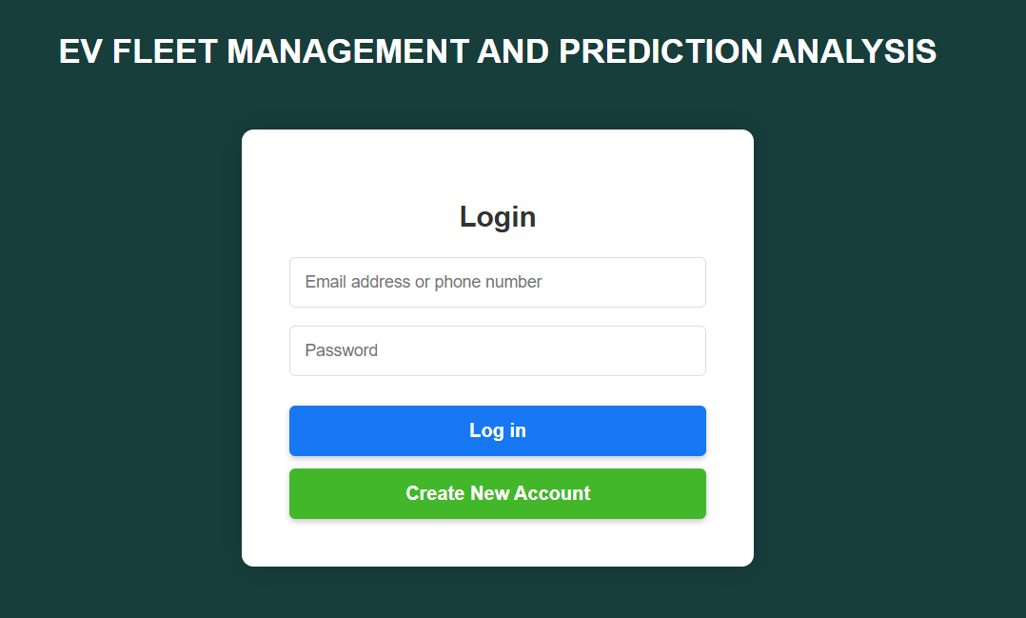
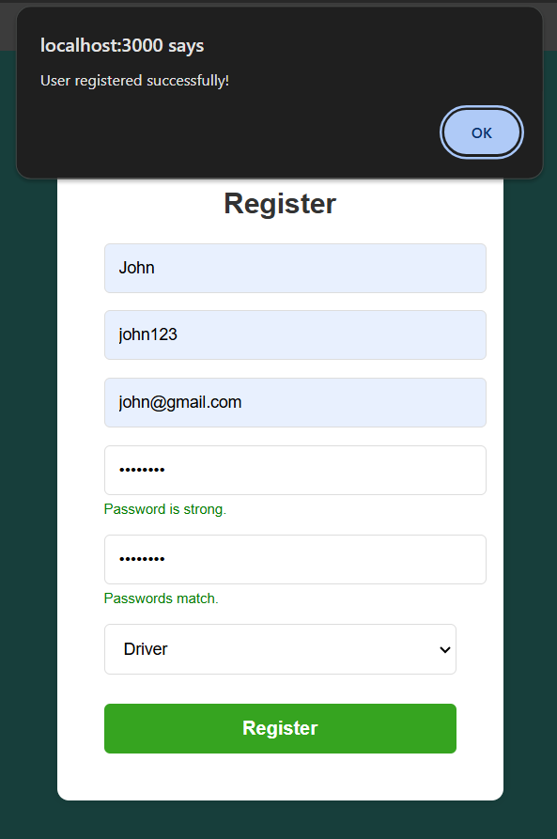
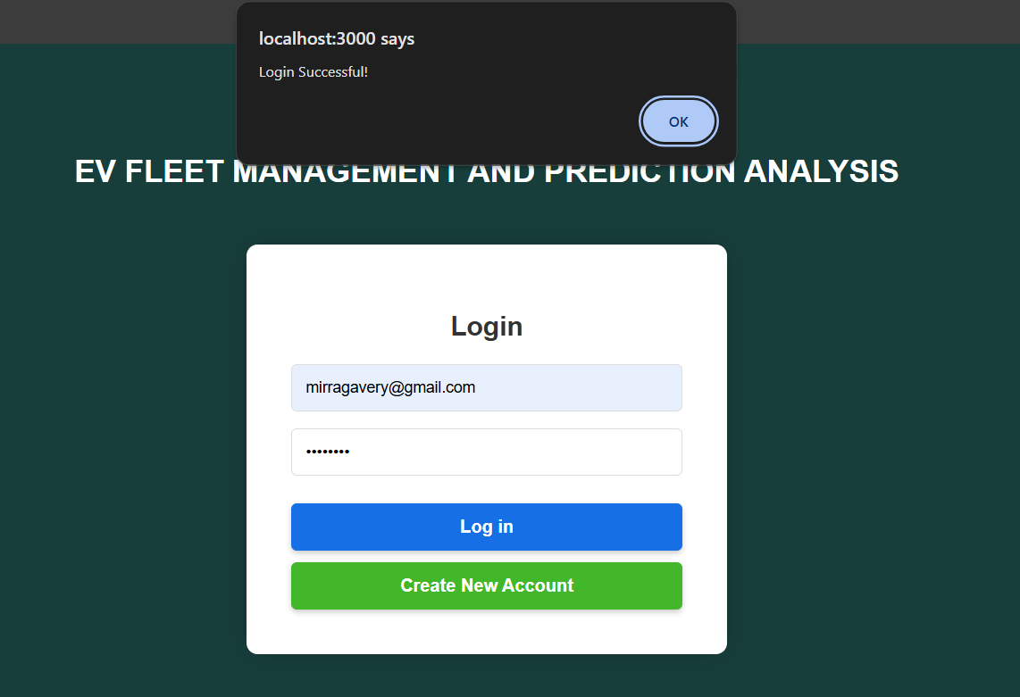
USER REGISTRATION AND LOGIN
This focuses on implementing a secure login and registration system. Users will be able to create accounts with email verification to ensure authenticity. The system will also incorporate role-based access control, granting fleet managers full access to the platform while providing drivers with restricted access according to their roles.

Slide 9
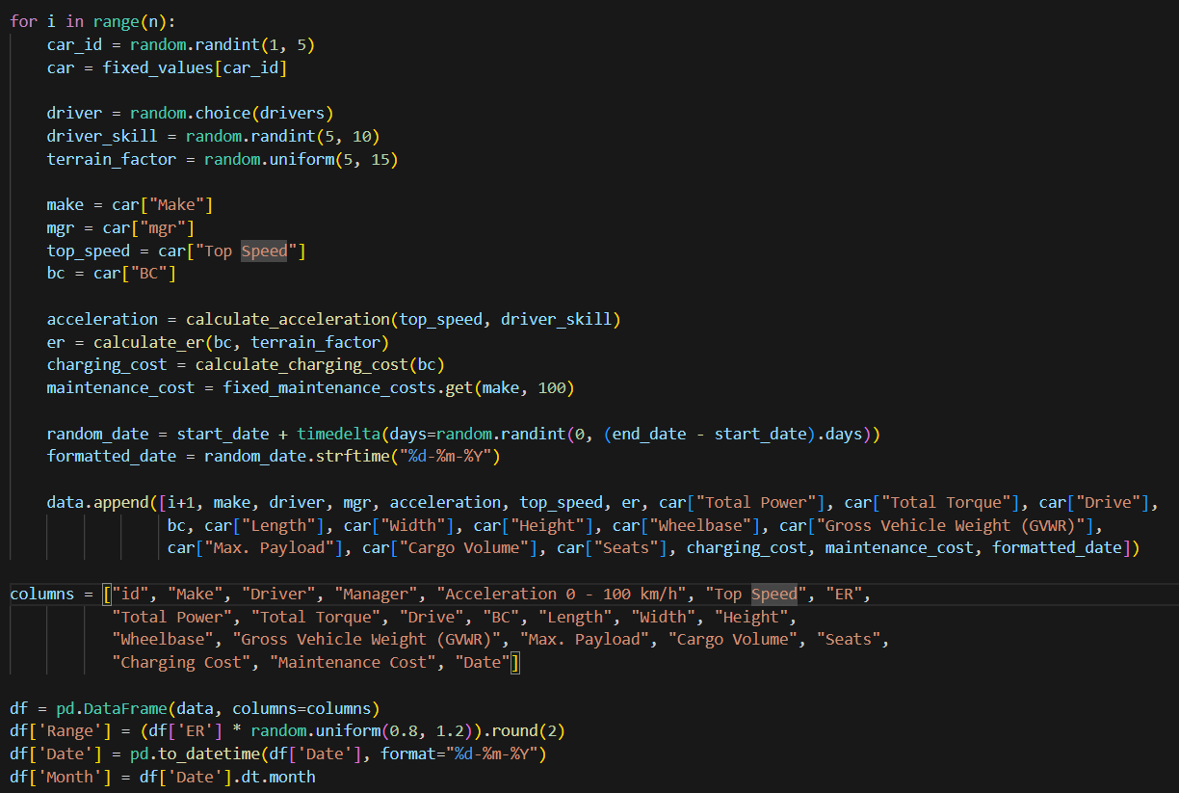
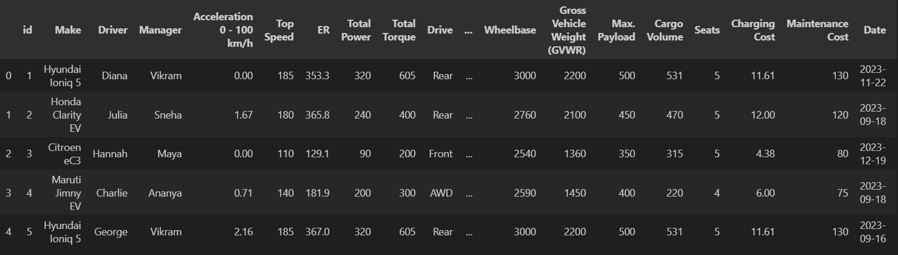
SYNTHETIC DATA GENERATION
Install Faker Library: Install Faker using pip install faker for generating realistic data.
Import Libraries: Use pandas, random, and Faker to generate and manage data.
Set Reproducibility: Initialize random seed for consistent data generation.
Generate columns : id, Make, Driver, Manager, Acceleration 0 - 100 km/h, Top Speed, ER, Total Power, Total Torque, Drive, BC, Length, Width, Height, Wheelbase, Gross Vehicle Weight (GVWR), Max. Payload, Cargo Volume, Seats, Charging Cost, Maintenance Cost, Date, Range, Month
Define Data Size: Specify the dataset’s number of rows (e.g., 1000).
Create Data Frame: Structure the data into a Pandas data frame.
Display Data: Visualize the dataset to ensure correctness and realism.

Slide 10
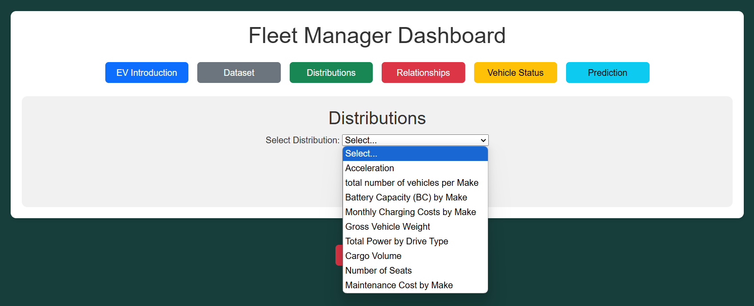
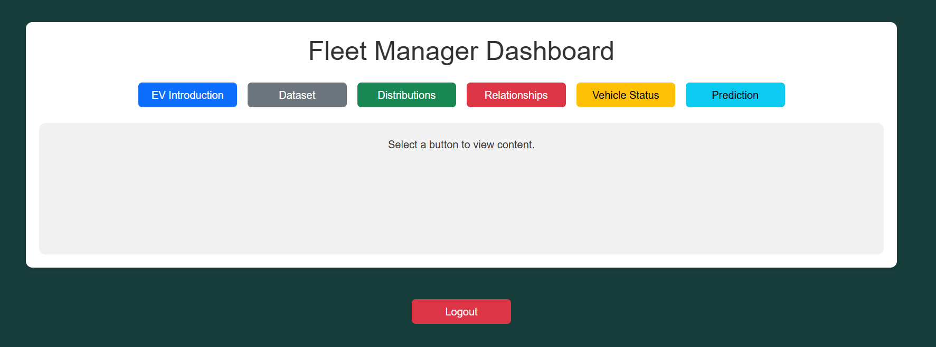
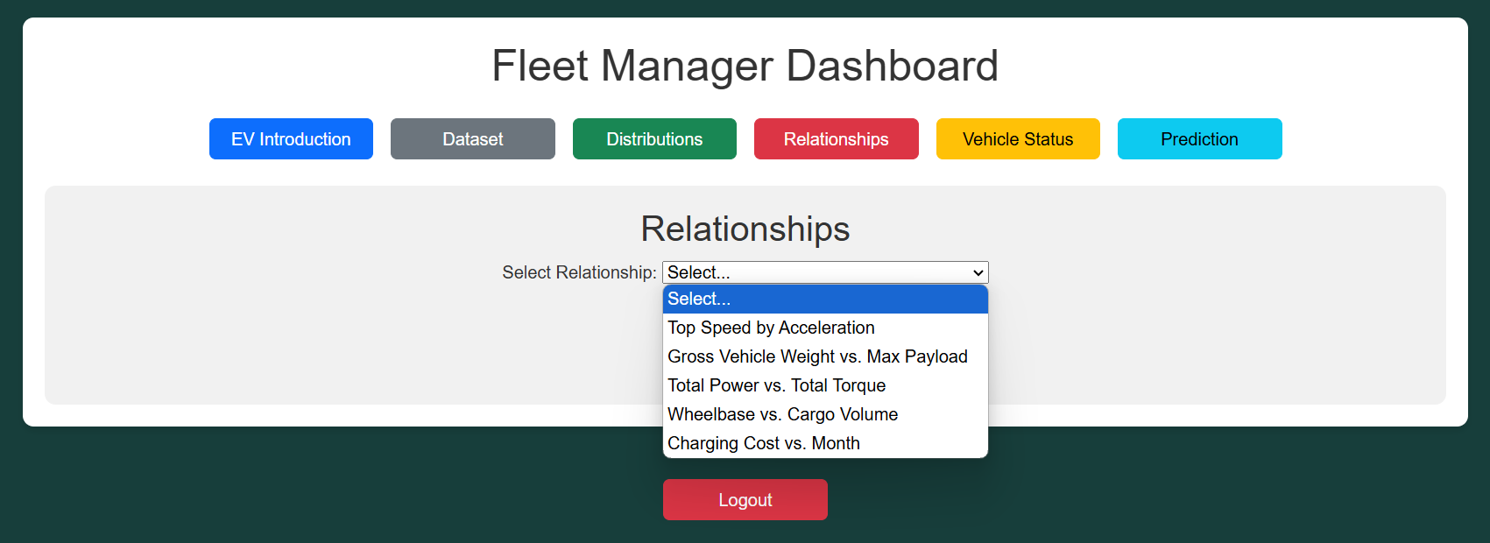
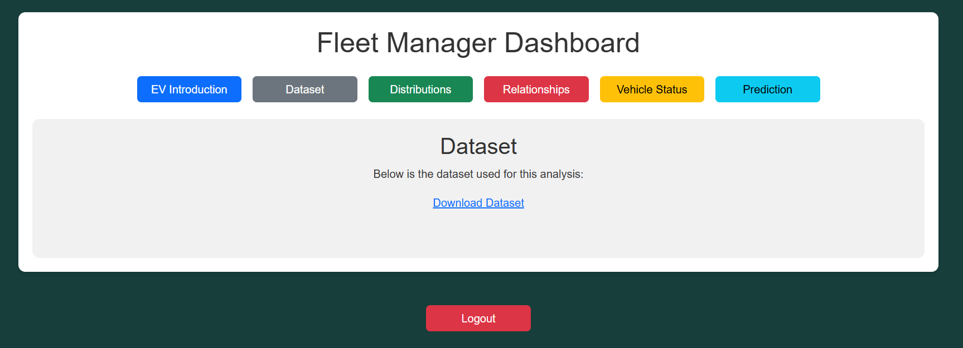
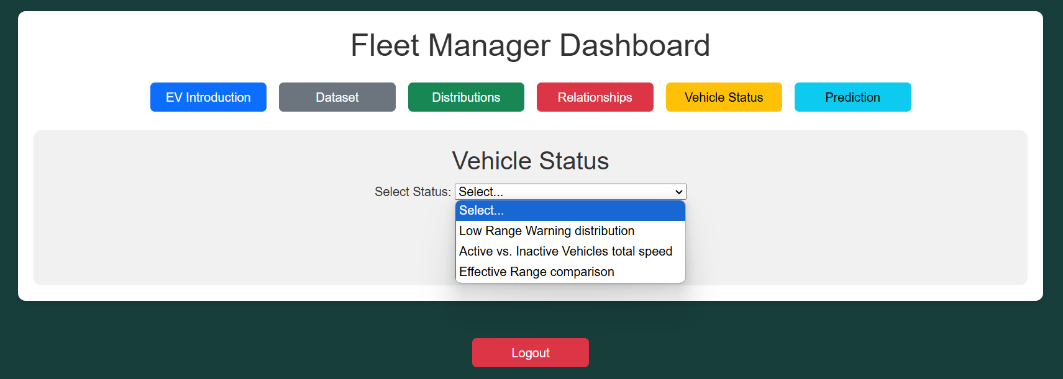
FLEET MANAGER DASHBOARD

Slide 11

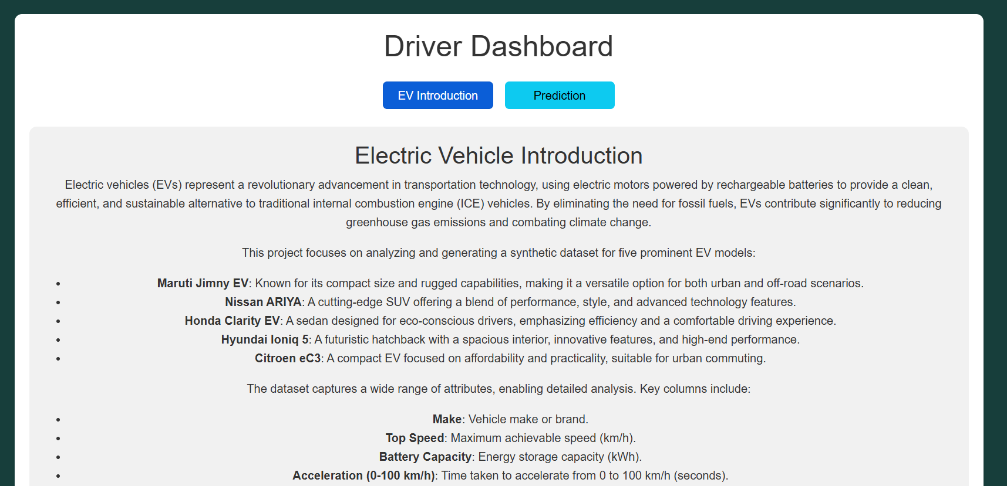
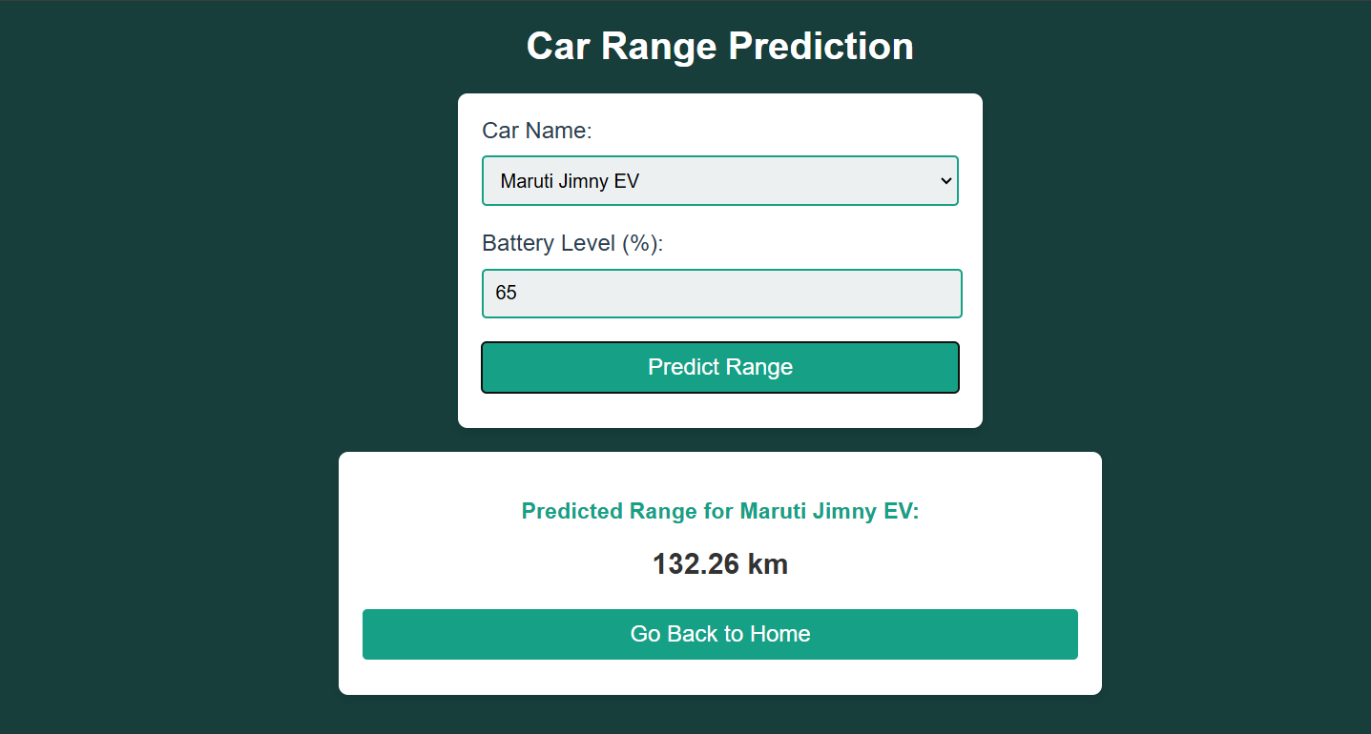
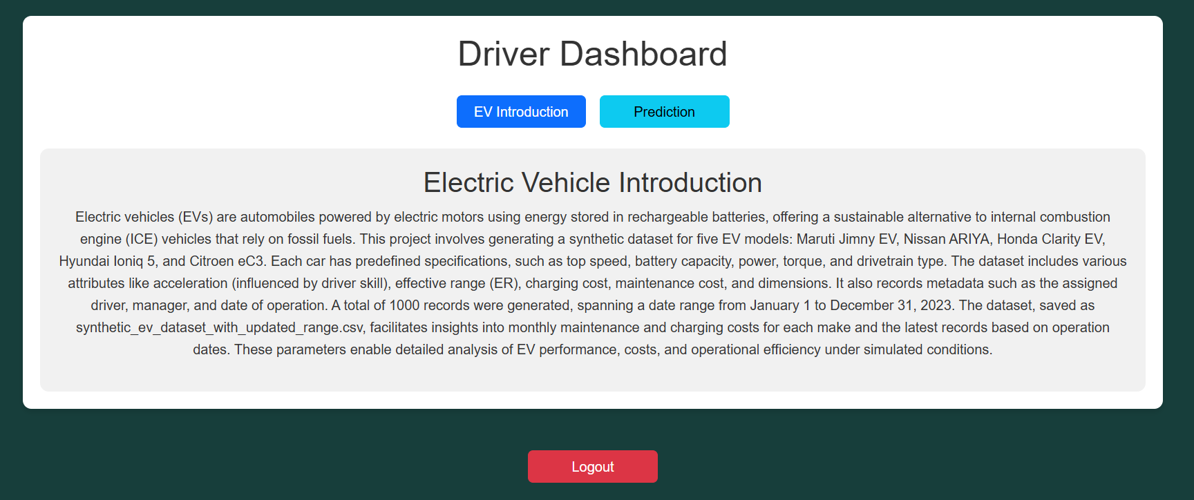
DRIVER DASHBOARD

Slide 12

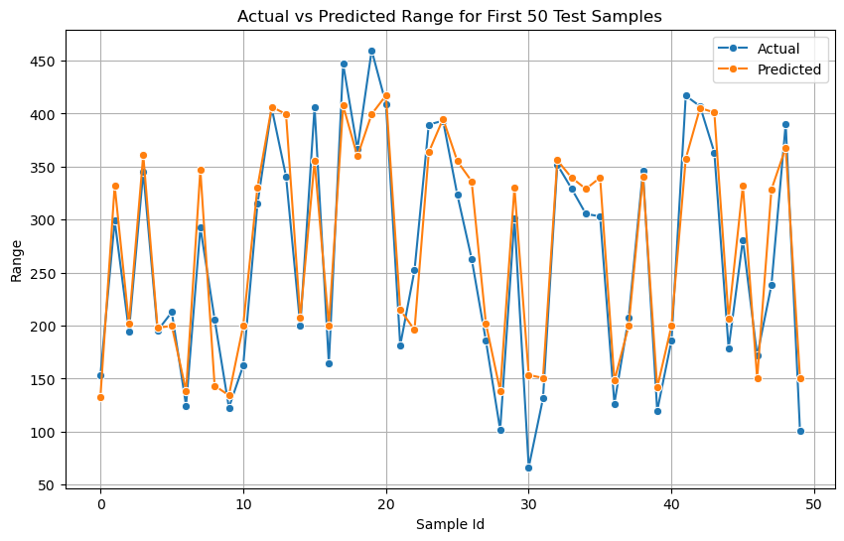
MACHINE LEARNING – LINEAR REGRESSION
Linear regression is used here to model the relationship between the target variable `Range` (e.g., the range of EVs) and the input features (such as driving behavior or environmental factors) in a simple and interpretable way. It assumes a linear relationship, which is often a reasonable starting point in predictive tasks. This method provides easily interpretable coefficients that show how each feature influences the target, making it valuable for fleet management insights. Additionally, linear regression is computationally efficient, making it suitable for quick predictions and serving as a baseline model before exploring more complex techniques.

Slide 13
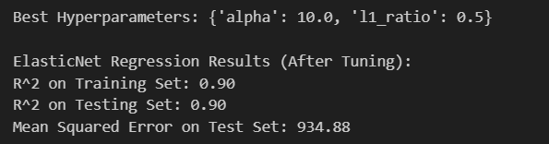
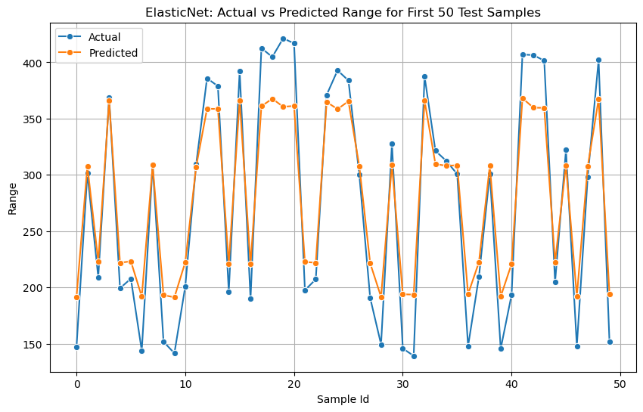
MACHINE LEARNING – ELASTICNET REGRESSION
ElasticNet regression is used here because it combines the benefits of both Ridge and Lasso regression, making it effective when there are multiple correlated features in the dataset. By incorporating both L1 (Lasso) and L2 (Ridge) regularization, ElasticNet helps manage multicollinearity and perform feature selection while avoiding overfitting. This is particularly useful in EV fleet management, where features such as environmental factors, vehicle attributes, and driving behavior can be highly correlated. ElasticNet provides a balance between model complexity and accuracy, ensuring robust predictions while improving generalization performance through regularization.

Slide 14
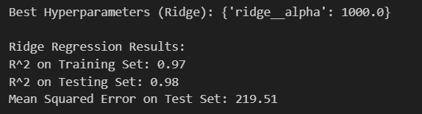
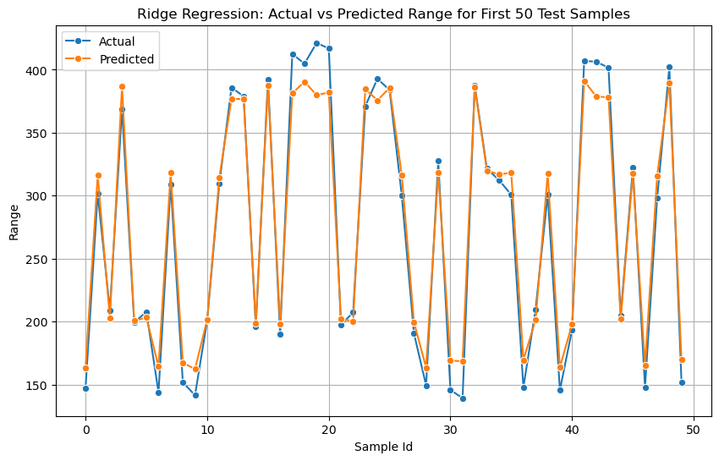
MACHINE LEARNING – RIDGE REGRESSION
Ridge regression is used here to address overfitting by applying L2 regularization to the model, which helps prevent the model from becoming too complex and overfitting to the noisy data. Since the target variable (`Range`) has been intentionally perturbed with noise, Ridge regression is beneficial because it penalizes large coefficients, leading to a simpler and more generalizable model. This is especially useful in a scenario where features might have high multicollinearity or the dataset includes irrelevant noise, as Ridge reduces the impact of such features, improving the model's robustness and predictive accuracy.

Slide 15
CONCLUSION
The Real-Time EV Fleet Monitoring and Predictive Analytics Solution helps fleet managers efficiently track vehicle performance, predict ranges, and reduce costs. By monitoring battery health, charging status, and energy usage, the system enables proactive maintenance and minimizes downtime. It also provides insights energy consumption, helping to improve fleet efficiency. With customizable reports and scalable features, the solution meets the evolving needs of EV fleet operations, driving both cost savings and operational improvements.

Slide 16
TEAM MEMBERS
MIRRA
UJWALA
BHARAT

Slide 17
THANK YOU!

